Slide 1

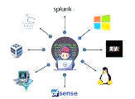

COMPUTER Network 22CSE62 –M.5.2
Notes:
DSDV (15EC663)
1

Slide 2
Module 5 -Application layer and Security mechanisms
Overview of:
Domain Name Space,
Remote Logging, Email, FTP, WWW, HTTP
Security – Network Layer Security, Application Layer Security

Slide 3
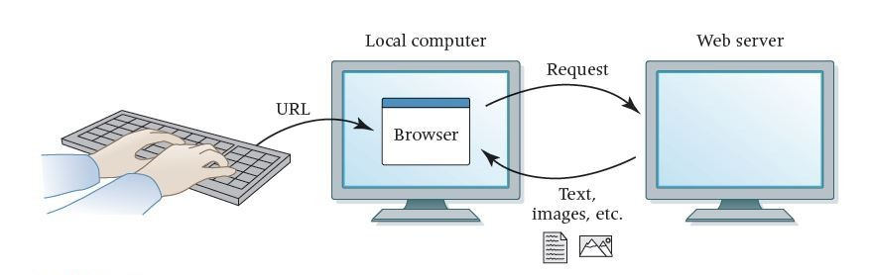
World Wide Web (www)
The World Wide Web (WWW) is a repository of information linked together from points all over the world.
The WWW has a unique combination of flexibility, portability, and user-friendly features that distinguish it from other services provided by the Internet.

Slide 4
World Wide Web (www)
Website: A collection of related web pages
Web browser: A software tool that retrieves and displays web pages
Web server: A computer set up to respond to requests for web pages
Uniform Resource Locator (URL): A standard way of specifying the location of a Web page, containing the hostname, "/", and a file

Slide 5
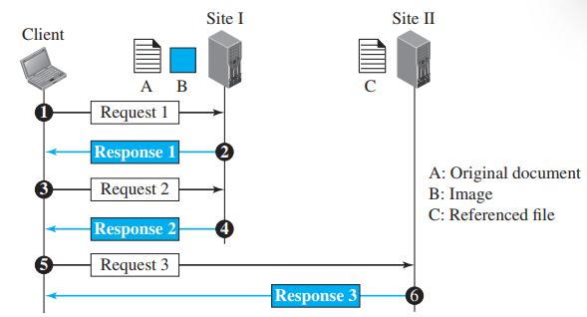
Architecture of WWW
The WWW today is a distributed client/server service, in which a client using a browser can access a service using a server.
The service provided is distributed over many locations called sites

Slide 6
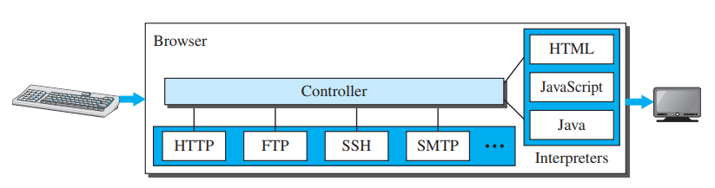
Client (Browser)
Each browser usually consists of three parts:
a controller,
client protocol, and
interpreters
The controller receives input from the keyboard or the mouse and uses the client protocols to access the document.
After the document has been accessed, the controller uses one of the interpreters to display the document on the screen.

Slide 7
Server
The Web page is stored at the server. Each time a client request arrives, the corresponding document is sent to the client.
To improve efficiency, servers normally store requested files in a cache in memory; memory is faster to access than disk.
A server can also become more efficient through multithreading or multiprocessing. In this case, a server can answer more than one request at a time.

Slide 8

Uniform Resource Locator
A URL is defined as any character string that identifies a resource
The URL defines four things: protocol, host computer, port, and path
https://meet.google.com/tsv-qyux-ppi

Slide 9
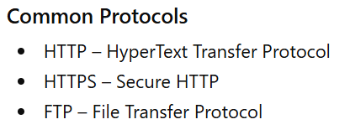
Uniform Resource Locator
The protocol is the client/server program used to retrieve the document.
Many different protocols can retrieve a document; among them are FTP or HTTP. The most common today is HTTP.

Slide 10
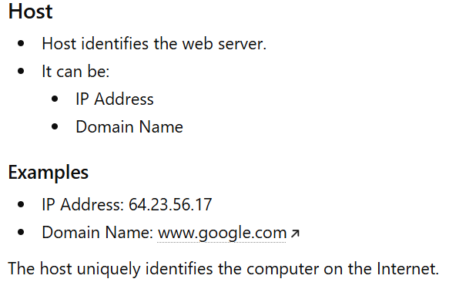
Uniform Resource Locator
The host is the computer on which the information is located.
Web pages are usually stored in computers, and computers are given alias names that usually begin with the characters "www". This is not mandatory.

Slide 11
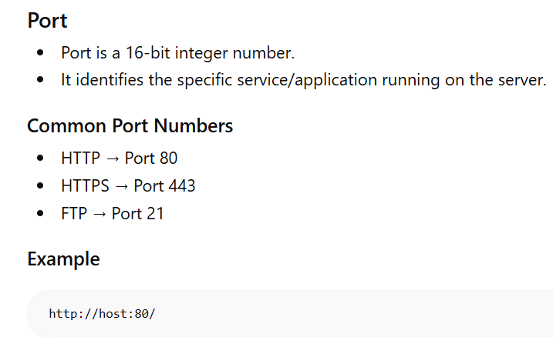
Uniform Resource Locator
The URL can optionally contain the port number of the server.
If the port is included, it is inserted between the host and the path, and it is separated from the host by a colon.

Slide 12
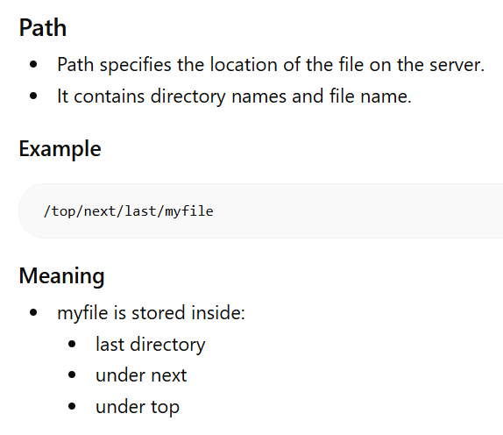
Uniform Resource Locator

Slide 13
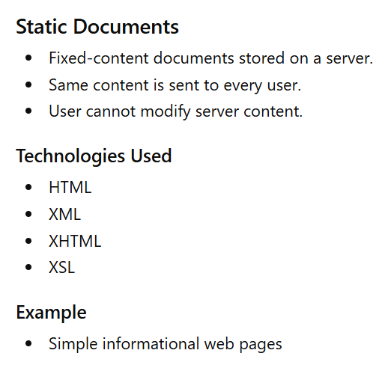
Types of Web Documents
Web documents are classified into:
Static Documents
Dynamic Documents
Active Documents

Slide 14
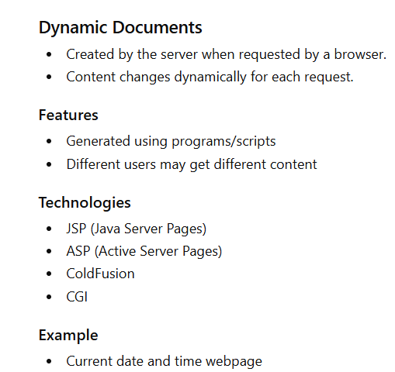
Types of Web Documents
Web documents are classified into:
Static Documents
Dynamic Documents
Active Documents

Slide 15
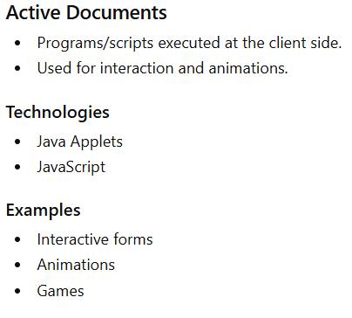
Types of Web Documents
Web documents are classified into:
Static Documents
Dynamic Documents
Active Documents

Slide 16
HyperText Transfer Protocol (HTTP)
The Hypertext Transfer Protocol (HTTP) is a protocol used mainly to access data on the World Wide Web.
HTTP functions as a combination of FTP and SMTP.
HTTP uses the services of TCP on well- known port 80.
It is similar to FTP because it transfers files and uses the services of TCP.
Unlike FTP there is no separate control connection; only data are transferred between the client and the server

Slide 17
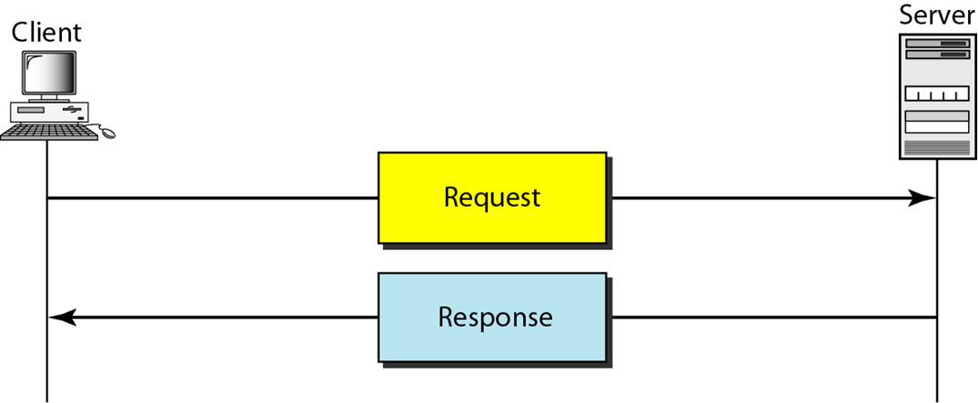
HTTP Transaction
HTTP uses the services of TCP, however HTTP itself is a stateless protocol.
The client initializes the transaction by sending a request message.
The server replies by sending a response message

Slide 18
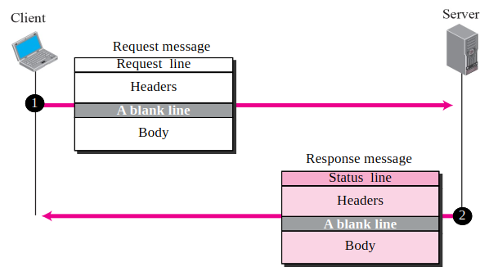
HyperText Transfer Protocol (HTTP)
A request message consists of a request line, a header, and sometimes a body.
A response message consists of a status line, a header, and sometimes a body

Slide 19
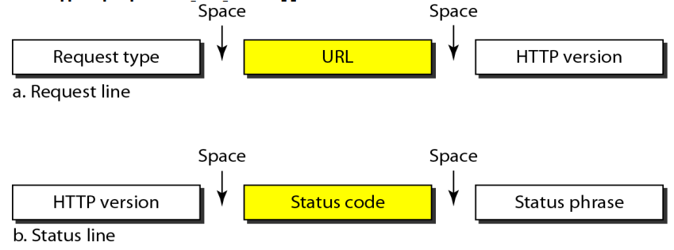
Request and Status Lines:
The first line in a request message is called a request line.
The first line in the response message is called the status line.

Slide 20
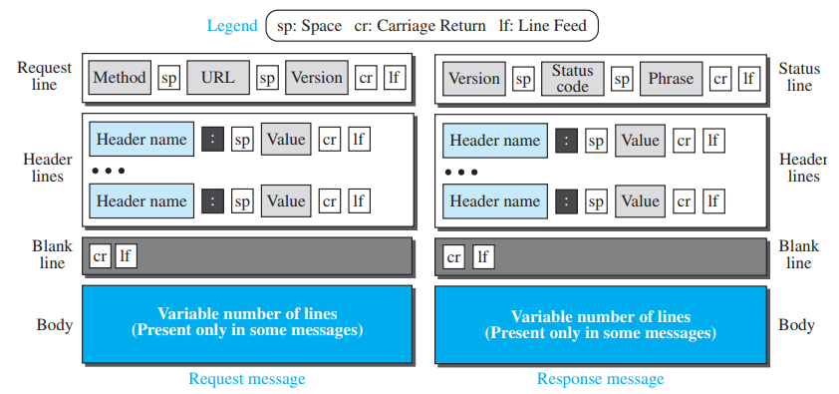
Format of the request message

Slide 21
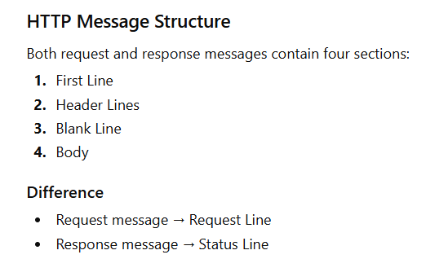
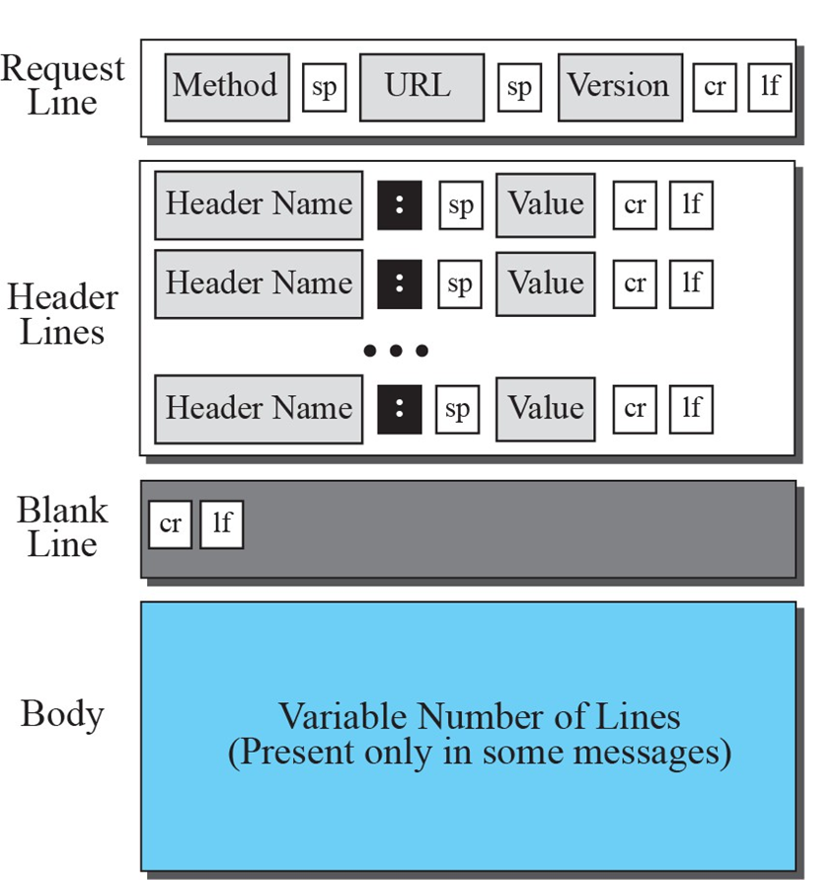

Slide 22
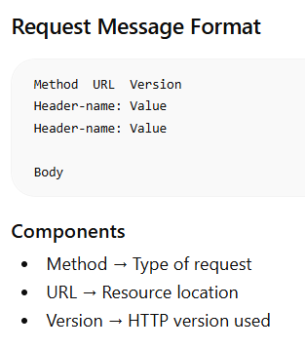
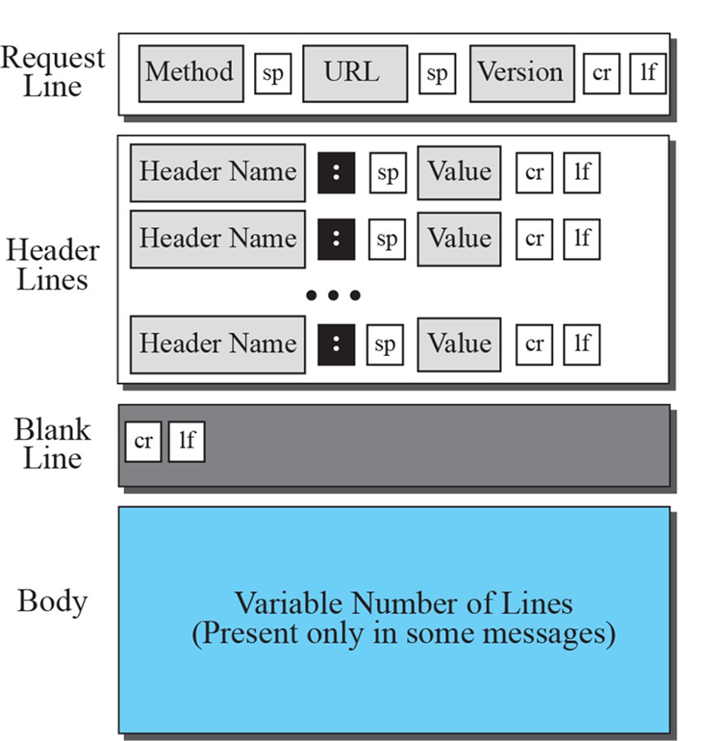
HTTP Request Message Format

Slide 23
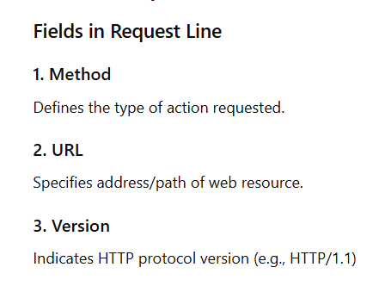


Slide 24
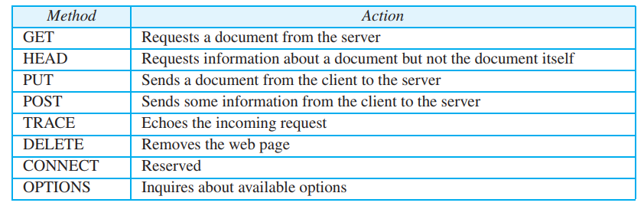

Slide 25
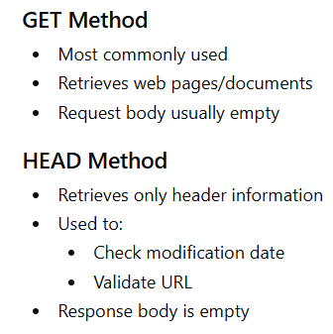
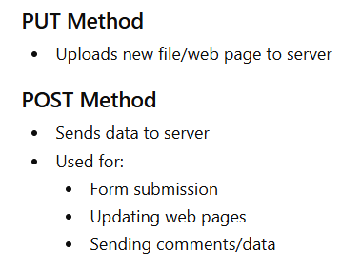
GET and HEAD Methods

Slide 26
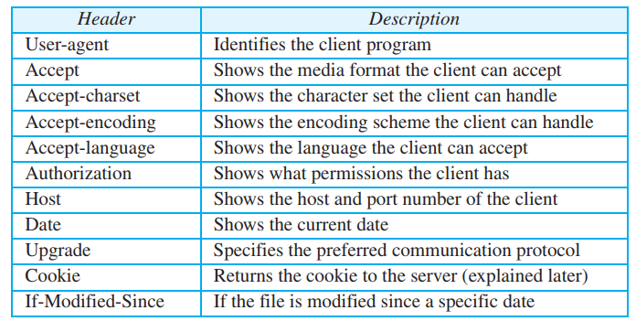
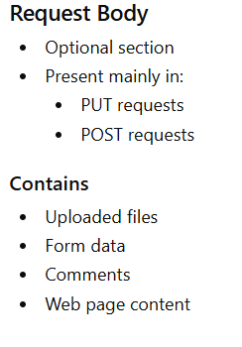
Request Header Fields

Slide 27
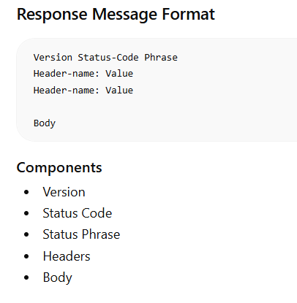
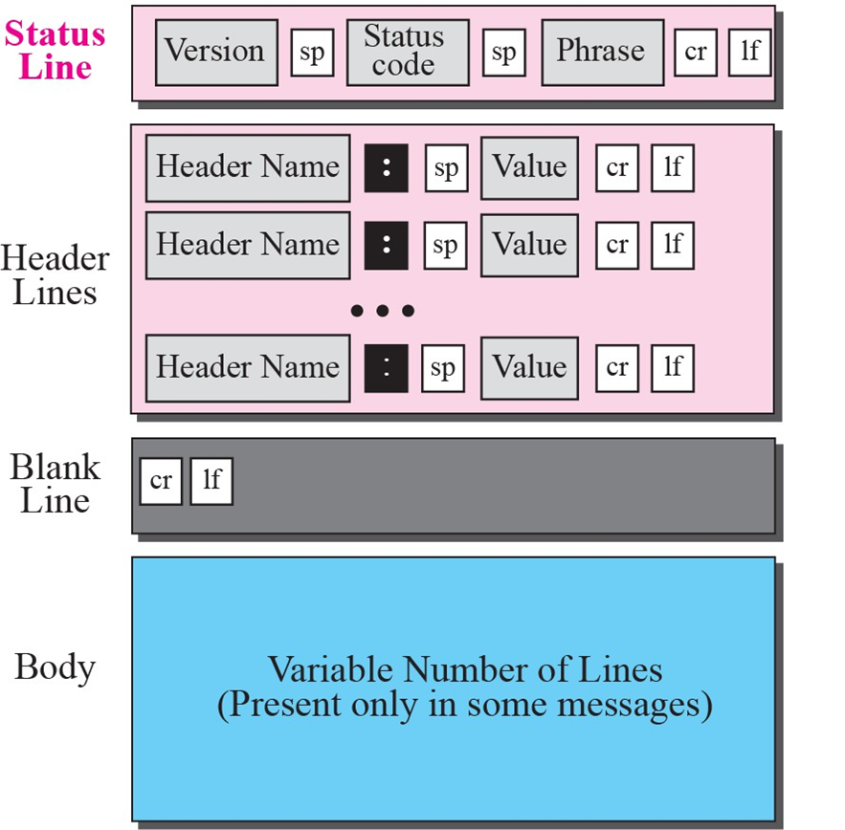
HTTP Response Message Format

Slide 28
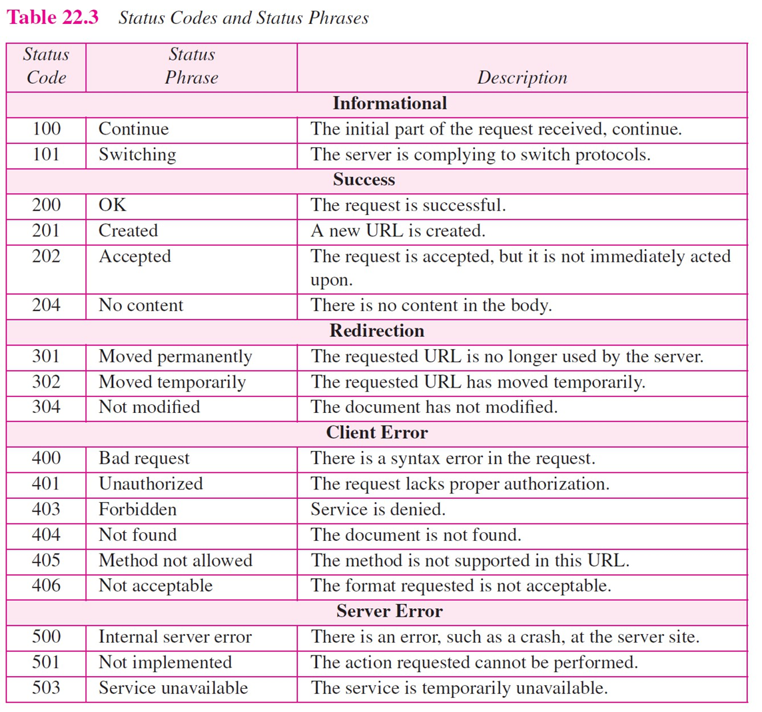
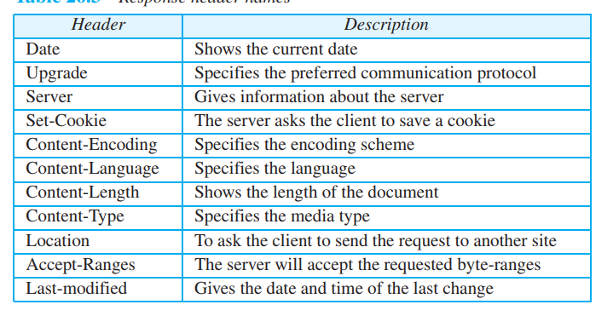

Slide 29
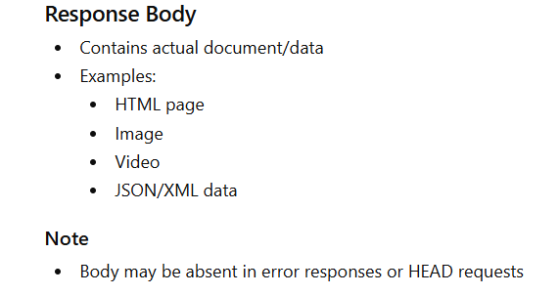

Slide 30
